Slide 1
Distributed File Systems

Slide 2
Introduction
A file is a collection of data organized by the user.
The data within a file isn't necessarily meaningful to the operating system.
Instead, a file is created by the user and meaningful to the user.
File System: it is all about organization, storage, retrieval, naming, sharing and protection.
Distributed file systems includes all components of files and also, in DS, the file systems work as resource management components.

Slide 3
Distributed file system
Distributed file system (DFS) is a method of storing and accessing files based in a client/server architecture.
Distributed File System talks about managing data, i.e. files or folders across multiple computers or servers.
In other words, DFS is a file system that allows us to store data over multiple nodes or machines in a cluster and allows multiple users to access data.
Examples of distributed file systems:
Sun Microsystems' Network File System (NFS)
Novell NetWare
Microsoft's Distributed File System
IBM/Transarc's DFS are some
Google File System

Slide 4
Design goals
A distributed file system should provide:
Network transparency:
hide the details of where a file is located.
High availability:
ease of accessibility irrespective of the physical location of the file.
Scalability:
no. of users, file servers, files handled etc.
Concurrency:
Handle concurrent access by different clients in the network

Slide 5
DFS Architecture
Client Server Architecture
Network File System (NFS)
Cluster Based Architecture
Google File Systems (GFS)

Slide 6
DFS: Architecture
In general, files in a DFS can be located in “any” system. We call the “source(s)” of files to be servers and those accessing them to be clients.
Potentially, a server for a file can become a client for another file.
However, most distributed systems distinguish between clients and servers in more strict way:
Clients simply access files and do not have/share local files.
Even if clients have disks, they (disks) are used for swapping, caching, loading the OS, etc.
Servers are the actual sources of files.
In most cases, servers are more powerful machines (in terms of CPU, physical memory, disk bandwidth, ..)

Slide 7
…
…
…
Server
Server
….
Server
Computer Network
Client
Client

Slide 8
How DFS works? (Architecture of DFS)
Client-1
Client-2
Cache Manager
Disk
Cache Manager
Disk
Network
Client-3
File Server
Cache Manager
Disk
Cache Manager
Server Disk

Slide 9
Request to
Access data
Return data
to client
Load data
to client cache
Load server
cache
Check
client
cache
Data present
Issue disk
read
Data Not present
Data Not present
Check
Local disk
(if any)
Check
Server cache
Data present
Data present
Send request to
File server
Network
Data Not present

Slide 10
Mechanisms for DFS
Mounting:
to help in combining files/directories in different systems and form a single file system structure.
Caching:
to reduce the response time in bringing data from remote machines.
Hints: modified caching
Bulk data transfer:
helps in reducing the delay due to transfer of files over the network. Bulk:
Obtain multiple number of blocks with a single seek
Format, transfer large number of packets in a single context switch.
Reduce the number of acknowledgements to be sent.
(e.g.,) useful when downloading OS onto a diskless client.
Encryption:
Establish a key for encryption with the help of an authentication server.

Slide 11
Mounting
Mounting helps to build a hierarchy of file directories.
A collection of files can be mounted at an internal node of the hierarchy.
Node at which this collection of files is mounted: mount point.
Operating systems kernel maintains a structure called the mount table, mapping mount points to appropriate storage devices.
Mount table can be maintained at:
Each client. Employed in Sun Network File System (NFS).
Servers. All clients see the same file system structure. Employed in Sprite file system.

Slide 12
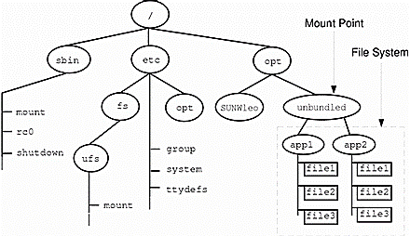
Name Space Hierarchy
Server X
Root (/)
Mount
Points
a
c
NOTE
Name refers to an object such as file or a directory.
Name Resolution refers to the process of mapping a name to an object that is physical storage.
Name space is collection of names.
b
g
d
e
f
h
i
Server Y
Server Z

Slide 13
Caching
Performance of distributed file system, in terms of response time, depends on the ability to “get” the files to the user.
When files are in different servers, caching might be needed to improve the response time.
A copy of data (in files) is brought to the client (when referenced). Subsequent data accesses are made on the client cache.
Client cache can be on disk or main memory.
Data cached may include future blocks that may be referenced too.
Caching implies DFS needs to guarantee consistency of data.

Slide 14
Hints
Caching is an important mechanism to improve the performance of a file system, however, guaranteeing the consistency of the cached items requires elaborate and expensive client/server protocols.
An alternative approach to maintaining consistency is to treat cached data (mostly meta data) as hints.
With this scheme, cached data is not expected to be completely consistent, but when it is, it can dramatically improve performance.
For maximum performance benefit, a hint should nearly always be correct.
Note that file data cannot be treated as a hint because use of the cached copy will not reveal whether it is current or stale.
Example:
After the name of a file or directory is mapped to a physical object in the server, the address of that object can be stored as a hint in the client's cache.
If the address fails to map to the object on a subsequent access, it is eliminated from the cache and the client must consult with the file server to determine the actual location of the object.

Slide 15
Design Issues for implementing DFS
Naming: Locating the file/directory in a DFS based on name.
Location of cache: disk, main memory, both.
Writing policy: Updating original data source when cache content gets modified.
Cache consistency: Modifying cache when data source gets modified.
Availability: More copies of files/resources.
Scalability: Ability to handle more clients/users.
Semantics: Meaning of different operations (read, write,…)

Slide 16
Naming
A name in a file systems is associated with an object.
Name space: (e.g.,) /home/students/jack, /home/staff/jill.
Mapping between logical and physical objects.
There are two notions regarding name mapping used in DFS.
Location Transparency: The name of a file does not give any hint of file's physical storage location.
Location Independence: The name of a file does not need to be changed when file's physical storage location changes.
A location independent naming scheme is basically a dynamic mapping. NFS does not support location independency.

Slide 17
Naming: Approaches ...
There are three major naming schemes used in DFS.
In the simplest approach
Files are named by some combination of machine or host name and the path name.
This naming scheme is neither location independent nor location transparent. This may be used in server side.
Second approach
is to attach or mount the remote directories to the local directories.
This scheme is used by NFS.
The third approach
is to use name space which is identical to all machines.
In practice, there are many special files that make this approach difficult to implement.

Slide 18
Naming: Context
Context: identifying the name space within which name resolution is to be done.
Example: context using ~ (tilde).
~jill/t: /home/staff/jill/t
~john/t: /home/students/john/t
~name: represents the directory structure associated with a person or a project.
Whenever file “t” is accessed, it is interpreted with reference to ~’s environment.
~ helps when different clients mount in different ways, still sharing the same of users and their home directories.
(e.g.,) ~john may be mapped to /home/students/john in client 1 and to /usr/students/john in client 2.

Slide 19
Name Resolution
Done by name servers that map file names to actual files.
Centralized name server: send names to the server and get the path of servers+devices that lead to the requested file.

Slide 20
Caching
The concept of caching is simple. If the data needed to satisfy the access request are not already cached, then a copy of those data is brought from the server to the client system.
CACHE Location
In main memory:
Faster than disks.
Diskless workstations can also cache.
Server-cache is in main memory -> same design can be used in clients also.
Disadvantage: clients need main memory for virtual memory management too.
In disks:
Large files can be cached.
Virtual memory management is straight forward.
After caching the necessary files, the client can get disconnected from network (if needed, for instance, to help its mobility).

Slide 21
Writing Policy
When should a modified cache content be transferred to the server?
Write-through policy:
Immediate writing at server when cache content is modified.
Advantage: reliability, crash of cache (client) does not mean loss of data.
Disadvantage: Several writes for each small change.
Delayed writing policy:
Write at the server, after a delay.
Advantage: small/frequent changes do not increase network traffic.
Disadvantage: less reliable, susceptible to client crashes.
Write at the time of file closing.

Slide 22
Cache Consistency
When should a modified source content be transferred to the cache?
Client-initiated consistency: Client contacts the server and asks if its copy is consistent with the server's copy.
Can check every access.
Can check at a given interval.
Can check only upon opening a file.
Server-initiated consistency: Server detects potential conflicts and invalidates caches
Server needs to know:
which clients have cached which parts of which files.
which clients are readers and which are writers.
Concurrent-write sharing policy:
Multiple clients open the file, at least one client is writing.
File server asks other clients to purge/remove the cached data for the file, to maintain consistency.
Sequential-write sharing policy: a client opens a file that was recently closed after writing.

Slide 23
Availability
Intention: overcome the failure of servers or network links.
Solution: replication, i.e., maintain copies of files at different servers.
Issues:
Maintaining consistency
Detecting inconsistencies, if they happen despite best efforts. Possible reasons for such inconsistencies:
Replica is not updated due to a server failure or a broken network link.
Inconsistency problems and their recovery may reduce the benefit of replication.

Slide 24
Replica Management
Two-phase commit protocols can be used to update all replicas.
Other schemes:
Weighted votes:
A certain number of votes r or w is to be obtained before reading or writing.
Current synchronization site (CSS):
Designate a process/site to control the modifications.
File open/close are done through CSS.
CSS can become a bottleneck.

Slide 25
Scalability
Ease of adding more servers and clients with respect to the problems / design issues discussed before such as caching, replication management, etc.
Server-initiated cache invalidation scales up better.
Using the clients cache:
A server serves only X clients.
New clients (after the first X) are informed of the X clients from whom they can get the data (sort of chaining/hierarchy).
Cache misses & invalidations are propagated up and down this hierarchy, i.e., each node serves as a mini-file server for its children.
Structure of a server:
I/O operations through threads (light weight processes) can help in handling more clients.

Slide 26
Semantics (What is the effect / meaning of an operation?)
Open File Permissions:
In Unix, for example:
A process opens a file with read-write mode
Later the owner of the file changes the file to read-only
The process can still read from and write to the file until it closes the file
In NFS, the process can only read from the file because each read/write is checked against
Reads and Writes
In Unix, each read/write is atomic: vnode and inode are locked
In NFS, a single read/write may span several RPC calls (max size of RPC packet is 8K)
Modern NFS provides Network Lock Manager to lock entire file or a portion of it. But it's advisory lock!

Slide 27
Google File System (GFS)
Google uses the GFS to organize and manipulate huge files and to allow application developers the research and development resources they require.
The GFS is unique to Google and isn't for sale.
Google doesn't reveal how many computers it uses to operate the GFS. In official Google papers, the company only says that there are "thousands" of computers in the system.

Slide 28
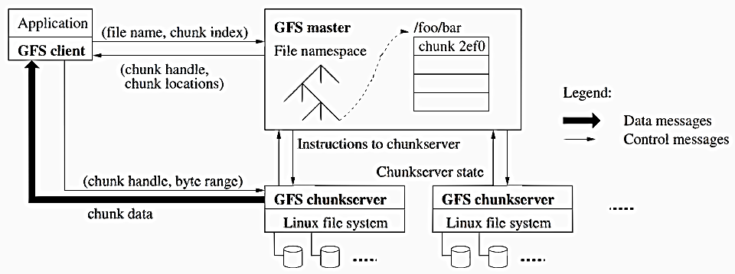
GFS Architecture

Slide 29
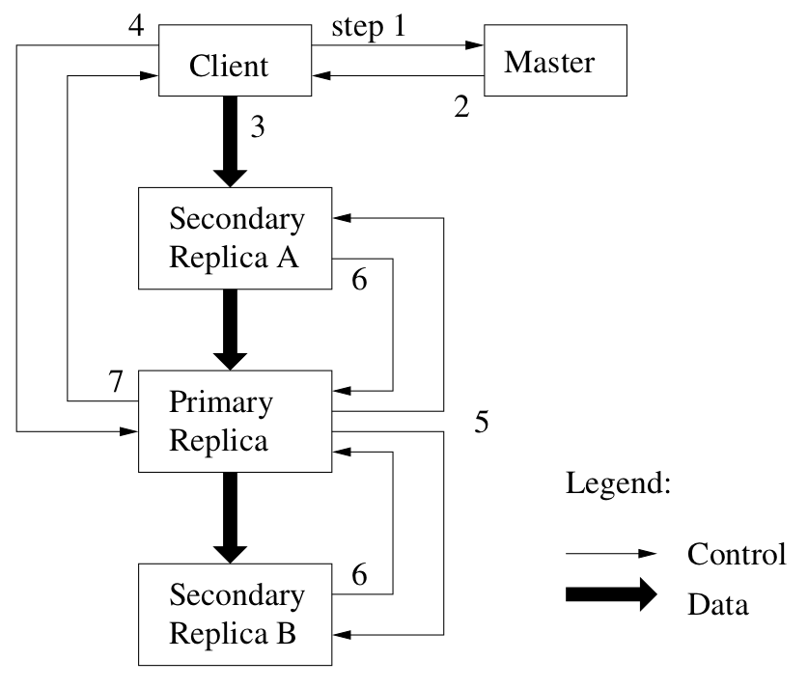



System Interactions

Slide 30
NFS (Network File System)
Using NFS, you can share the file system resources (as well as printers) across a network. Hence, other hosts on the network can access the remote storage, just like their local storage.
NFS was developed in 1970 by Sun Microsystems. Nowadays NFS is an integrated part of every *nix operating system. (NFS Version 4.1)
NFS is a client/server protocol, which means a server shares its storage resources and other client(s) can access the shared resources on the server.

Slide 31
Sun NFS
Major goal: keep the distributed file system independent of underlying hardware and operating system.
NFS uses the Remote Procedure Call (RPC) for remote file operations.
Virtual file system (VFS) interface: provides uniform, virtual file operations that are mapped to the actual file system. (e.g.,) VFS can be mapped to DOS, so NFS can work with PCs.
VFS uses a structure called vnode (virtual node) that is unique in a NFS.
Each vnode has a mount table that provides a pointer to its parent file system and to the system over which it is mounted.

Slide 32
Sun NFS...
A vnode can be a mount point.
Using mount tables, VFS interface can distinguish between local and remote file systems.
Requests to remote files are routed to the NFS by the VFS interface.
RPCs are used to reach remote VFS interface.
Remote VFS invokes appropriate local file operation.

Slide 33
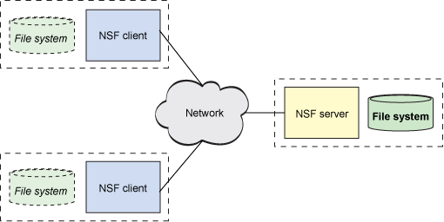
The NFS architecture
NFS follows the client-server model of computing.
The server implements the shared file system and storage to which clients attach.
The clients implement the user interface to the shared file system, mounted within the client’s local file space.

Slide 34
Sun NFS Architecture
Client
Kernel
OS Interface
Server
VFS Interface
Server
Routines
VFS Interface
Others
Unix
NFS
Disks
Disk
RPC/XDR
RPC/XDR
Network

